Slide 1
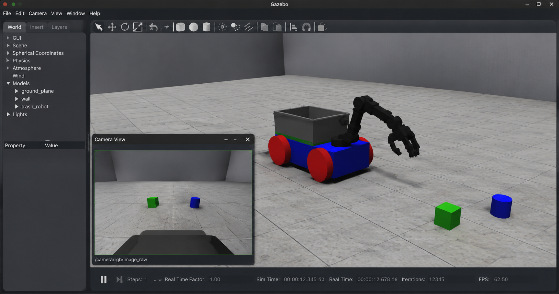
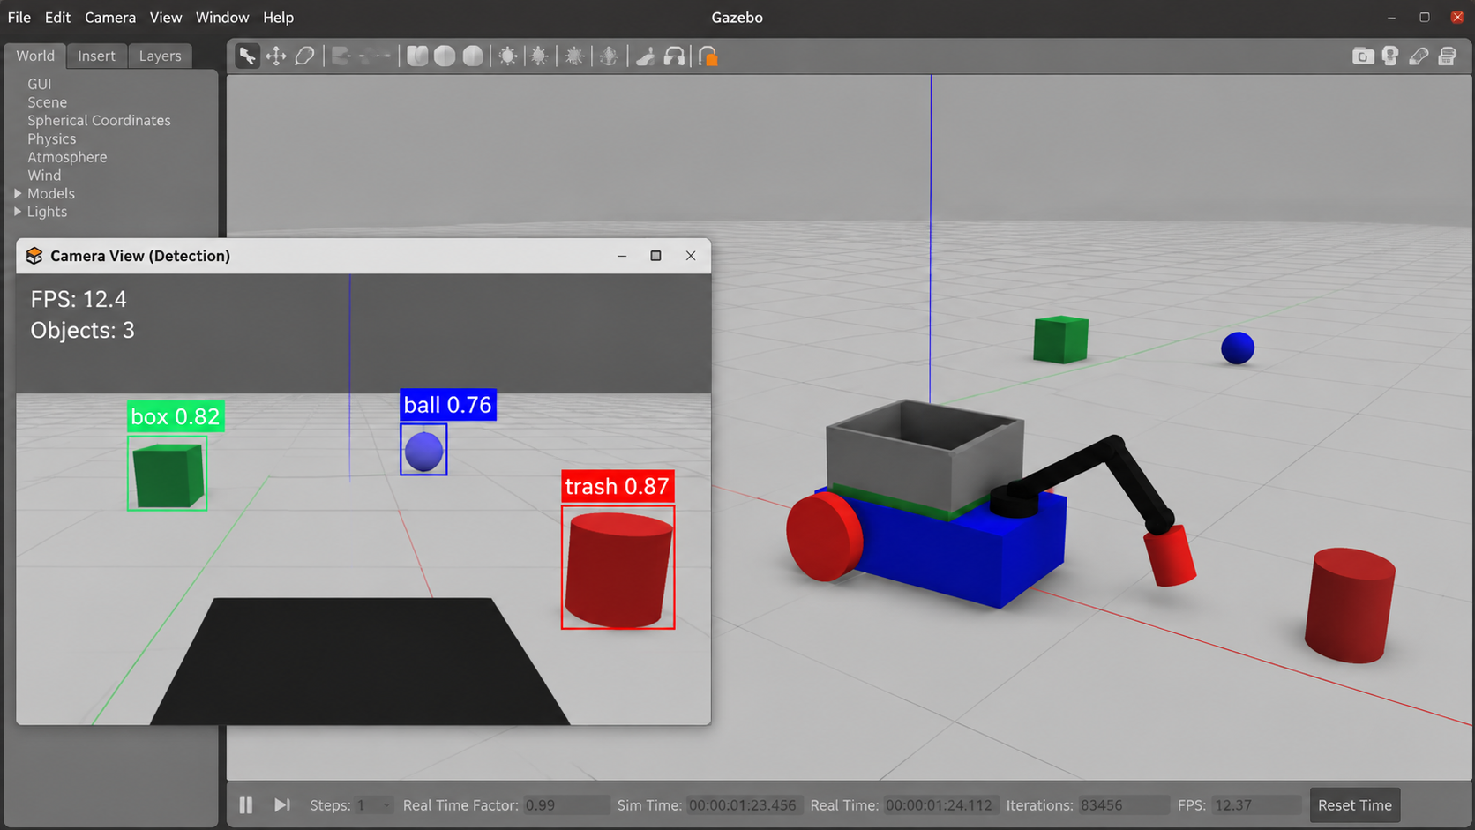
ROS 2-Based Autonomous Trash Collecting Robot
with Computer Vision and Robotic Manipulation
IRE 316 Embeded Systems Sessional
Mst. Esat Jahan Akhi(2201022) · Jannatul Ferdusi Ayesha(2201002) · Mst. Sukria Akter(2201021)
Department of Internet of Things and Robotics Engineering (IRE)
University of Frontier Technology, Bangladesh
Notes:
Introduce the project: an autonomous trash collecting robot built on ROS 2 and evaluated in Gazebo Classic. The two images show the simulated robot and the camera-based detection output.

Slide 2
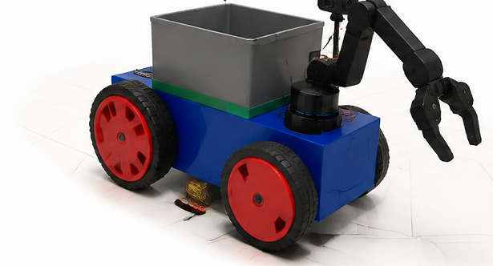
Outline
01
Introduction
02
Literature Review
Background & motivation
Detection & robotic collection
From problem to working simulation
03
Research Gap
04
System Architecture
Comparison with prior work
Layers & robot model
05
Methodology
06
ROS 2 Communication
Control algorithm & workflow
Nodes & topics
07
Results & Discussion
08
Conclusion
Simulation & evaluation
Limitations & future work
Notes:
Quick roadmap: motivation, literature and gap, the proposed architecture and control method, ROS 2 communication, then results and conclusions.

Slide 3




INTRODUCTION
Why Autonomous Waste Collection?
Rapid urbanization
Manual collection limits
Monitoring ≠ collecting
Population growth is increasing solid waste in public spaces, straining collection and environmental management.
Traditional collection depends on manual labor: time-consuming, inefficient and unhealthy for workers.
IoT and AI smart-waste systems mostly detect waste status; they do not physically collect scattered waste.
Our approach
A mobile robot that detects, approaches, grasps and disposes of waste, covering the complete operational cycle in ROS 2 and Gazebo.
ROS 2-Based Autonomous Trash Collecting Robot
Notes:
Motivation: waste volumes are rising and manual collection is inefficient. Smart-bin style systems monitor waste but do not collect it. Our robot targets the full cycle: detect, approach, grasp, dispose.

Slide 4




INTRODUCTION
Objectives and Contributions
Design objectives
Key contributions
Reliable waste perception
Integrated robot architecture
1
Camera perception, LiDAR sensing, ROS 2 communication, navigation and manipulation in one mobile platform.
Real-time communication among robot modules
Simulation-based platform for waste handling
2
Reproducible Gazebo environment with robot model, sensors, trash objects, robotic arm and gripper.
Autonomous movement toward detected objects
Effective waste handling with arm and gripper
ROS 2 perception-to-action control
3
Sensor processing, navigation and arm operation connected through coordinated communication.
ROS 2-Based Autonomous Trash Collecting Robot
Notes:
Four design objectives on the left; three contributions on the right: integrated architecture, a reproducible Gazebo platform, and a ROS 2 perception-to-action control strategy.

Slide 5

LITERATURE REVIEW · 1 OF 3
Vision-Based Waste Detection
Work | Approach / focus | Limitation
DSYOLO-trash [4] Ma et al., 2024 | Attention mechanism + object tracking for solid waste | Detection and tracking only
MRS-YOLO [5] Ren et al., 2024 | High-precision detection and classification in complex conditions | No robot integration
DRSE-YOLO [6] Sun & Zhang, 2025 | Efficient, lightweight architecture for waste detection | Perception only; no navigation or pickup
YOLOv8n system [7] Khamis et al., 2025 | YOLOv8n-based trash detection for smart waste management | Recognition, not collection
HGCS-Det [10] Zhou et al., 2025 | Localizing and recognizing household garbage in complex scenes | Vision-only solution
Scene-guided YOLO [11] Hu et al., 2026 | Contextual feature fusion for diverse real-world environments | Detection focus only
Key takeaway
Deep-learning detectors have become accurate and lightweight, but they stop at recognition. None of them navigates, grasps or disposes of waste.
ROS 2-Based Autonomous Trash Collecting Robot
Notes:
These works advance perception: attention-based detection, high-precision classification, and lightweight real-time models. Their shared limitation is that they only detect and classify.

Slide 6





LITERATURE REVIEW · 2 OF 3
Robotic Waste Collection and Sorting
SHIFT-T [3]
Smart Waste Robot [1]
WasteSortBot [2]
Zaman et al., 2024
Islam et al., 2024
Hossen et al., 2025
Low-cost autonomous mobile robot for trash collection and sorting.
Gap: Limited manipulation.
Combines IoT, AI, SLAM and CNN-based image processing for collection and categorization.
Gap: Higher system complexity.
Vision-based multi-category waste separator bin using ROS and cloud computing.
Gap: Limited mobile platform.
Vision-guided arm [8]
Autonomous Litter Robot [9]
Other robotic studies [12]–[15]
Chaidir et al., 2025
Dube et al., 2025
2024–2026
Holonomic wheeled robot arm with YOLOv5 for waste sorting.
Gap: Limited collection.
Litter collecting robot with integrated detection and sorting capabilities.
Gap: Limited ROS use and simulation.
Floating-debris collection, quadruped trash containers, door-operating arms, mobile classification robots.
Gap: Task-specific designs.
ROS 2-Based Autonomous Trash Collecting Robot
Notes:
Robotic systems combine perception with mobility or manipulation, but each has a limitation: limited manipulation, higher complexity, limited mobility, limited collection, or task-specific design.

Slide 7
LITERATURE REVIEW · 3 OF 3
Comparison with Existing Approaches
Work | Vision | ROS | Mobile Robot | Robotic Arm | Collection | Simulation
DSYOLO-trash [4] | Yes | No | No | No | No | No
MRS-YOLO [5] | Yes | No | No | No | No | No
SHIFT-T [3] | Yes | Yes | Yes | Limited | Yes | Yes
Islam et al. [1] | Yes | Yes | Yes | Limited | Yes | Yes
WasteSortBot [2] | Yes | Yes | Limited | Yes | Yes | Limited
Chaidir et al. [8] | Yes | Yes | Yes | Yes | Limited | Yes
Autonomous Litter Robot [9] | Yes | Limited | Yes | Yes | Yes | Limited
Proposed Robot | Yes | Yes | Yes | Yes | Yes | Yes
Only the proposed robot covers the full detection, navigation, pickup and disposal cycle in a ROS-based simulation.
ROS 2-Based Autonomous Trash Collecting Robot
Notes:
This is Table I from the paper. Vision-only works score No on everything else. Existing robotic systems are partial in arm, collection, mobility or simulation. The proposed robot is the only one with Yes across all columns.

Slide 8




RESEARCH GAP
What Is Still Missing
Vision-based detection
Sorting and collection
This work
Deep-learning models recognize waste well, but detection and classification are where they end.
Systems handle collection or sorting under specific conditions; manipulation, autonomy or simulation is often limited.
One unified ROS 2 and Gazebo framework: detect, navigate, grasp and dispose of waste end to end.
A complete autonomous workflow that combines perception, navigation and manipulation remains challenging. This work integrates them in a single simulation framework.
ROS 2-Based Autonomous Trash Collecting Robot
Notes:
Research gap: vision work stops at detection; robotic work often handles sorting or collection under narrow conditions. We integrate detection, movement and pickup in one ROS 2 and Gazebo framework.

Slide 9
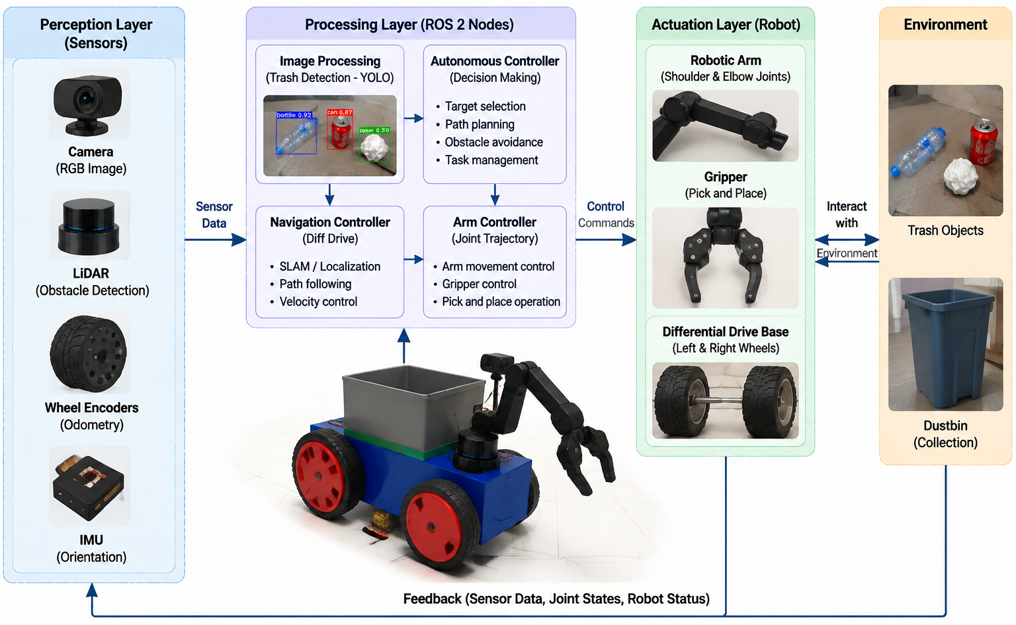


SYSTEM ARCHITECTURE
Three-Layer Robot Architecture
Perception
RGB camera and LiDAR collect environment data. The camera feeds trash detection; LiDAR supports obstacle awareness.
Decision-making
ROS 2 nodes analyze sensor data, select targets, plan paths and generate control commands.
Action
Differential-drive base and a robotic arm with gripper approach, pick and dispose of waste.
ROS 2-Based Autonomous Trash Collecting Robot
Notes:
Figure 1. Perception layer: RGB camera, LiDAR, wheel encoders, IMU. Processing layer: ROS 2 nodes for image processing, autonomous control, navigation and arm control. Actuation layer: robotic arm, gripper and differential drive base. Feedback returns sensor data, joint states and robot status.

Slide 10
SYSTEM ARCHITECTURE
Simulation Platform and Robot Model
Component | Description
Simulation Platform | Gazebo Classic
Middleware | ROS 2 Humble
Robot Model | SDF-based Mobile Robot
Vision Sensor | RGB Camera
Distance Sensor | LiDAR
Navigation | Differential Drive Control
Manipulator | Robotic Arm with Gripper
Control Framework | ROS 2 Nodes and Topics
The robot is defined in Simulation Description Format (SDF): mechanical components, joints, sensors and plugins. A differential-drive base moves the robot while the arm grasps and places waste.
ROS 2-Based Autonomous Trash Collecting Robot
Notes:
Figure 3 shows the Gazebo Classic world with the robot, camera view inset and waste objects. Table III lists the software and hardware components.

Slide 11


METHODOLOGY
State-Based Autonomous Control
STATE 1
STATE 2
STATE 3
STATE 4
STATE 5
STATE 6
Search
Detection
Approach
Pickup
Transfer
Complete
Camera-based environment scanning
Waste object identification
Mobile robot navigation
Arm and gripper operation
Move waste to container
Resume searching
GRASPING SEQUENCE
Stop mobile base
→
Lower arm
→
Open gripper
→
Grasp waste object
→
Transfer to container
ROS 2-Based Autonomous Trash Collecting Robot
Notes:
The controller is a sequential state machine (Table II). It starts in Search, moves to Detection when trash is seen, approaches, stops, runs the grasping sequence, transfers the object to the container, then resumes searching.

Slide 12
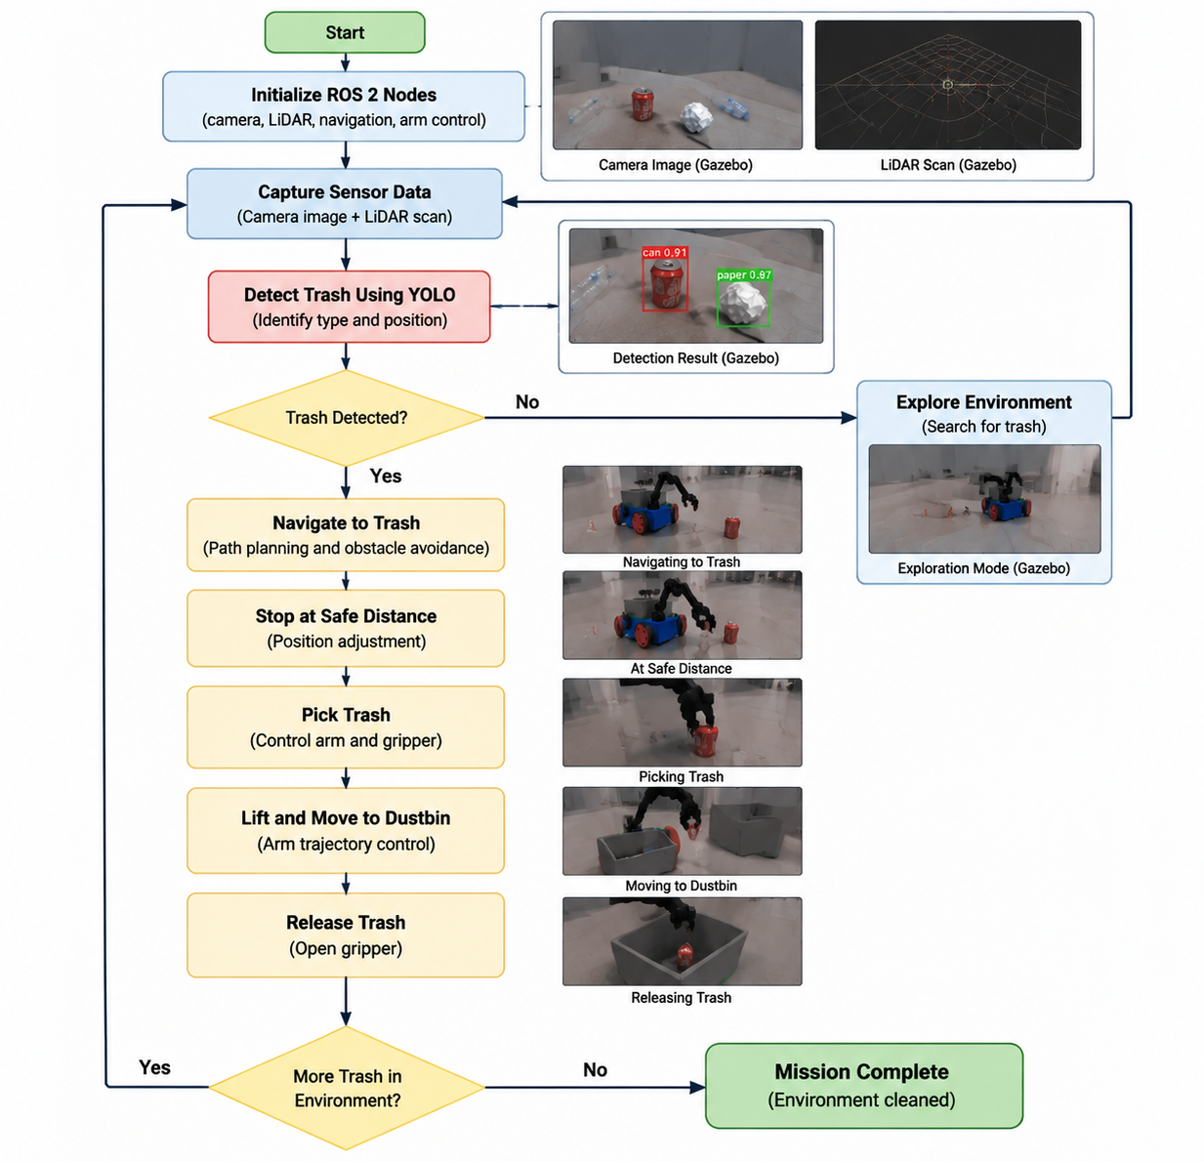
METHODOLOGY
End-to-End Collection Workflow
1
Initialize
Start ROS 2 nodes for camera, LiDAR, navigation and arm control.
2
Sense and detect
Capture camera image and LiDAR scan, then identify trash type and position.
3
Explore or approach
If no trash is found, explore. Otherwise navigate with obstacle avoidance and stop at a safe distance.
4
Pick and dispose
Control arm and gripper, lift the object, move to the dustbin and release.
5
Repeat
Continue while trash remains; finish with Mission Complete.
ROS 2-Based Autonomous Trash Collecting Robot
Notes:
Figure 2. The loop runs until no trash remains. The small inset images show the Gazebo camera image, LiDAR scan, detection result, and each stage: navigating, at safe distance, picking, moving to dustbin, releasing.

Slide 13
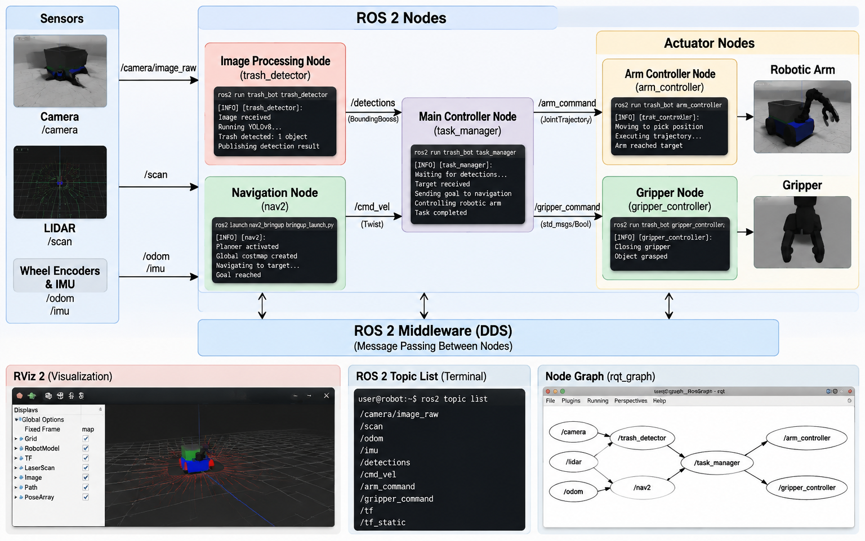

ROS 2 COMMUNICATION
Nodes, Topics and Middleware
Sensors to nodes
/camera/image_raw, /scan, /odom and /imu feed the detection and navigation nodes.
Task manager
The main controller coordinates detection, navigation, arm and gripper nodes.
DDS middleware
Message passing lets each module be developed and tested independently.
ROS 2-Based Autonomous Trash Collecting Robot
Notes:
Figure 4. Sensors publish to ROS 2 nodes: trash_detector, nav2, task_manager, arm_controller and gripper_controller. All communicate through the DDS middleware. RViz 2, the topic list and the rqt node graph are shown for visualization.

Slide 14
ROS 2 COMMUNICATION
Topic-Level Data Flow
Topic | Function
/camera/image_raw | Camera data input
/scan | LiDAR measurement
/cmd_vel | Mobile robot control
/joint_states | Joint feedback
/set_joint_trajectory | Arm command
/odom | Robot position feedback
Camera
Drive base
/camera/image_raw
Controller
/cmd_vel
ROS 2 nodes
perception → action
LiDAR
Arm + gripper
/scan
/set_joint_
trajectory
Sensors
Actuators
Feedback
/joint_states /odom
Arm and gripper commands travel as ROS 2 joint trajectory messages; /joint_states reports the arm's current joint positions.
ROS 2-Based Autonomous Trash Collecting Robot
Notes:
Table IV. Camera images arrive on /camera/image_raw and LiDAR on /scan. The controller sends /cmd_vel to the differential drive and joint trajectory commands to the arm. /joint_states and /odom return feedback.

Slide 15

RESULTS AND DISCUSSION
Experimental Setup and Trash Detection
Experimental setup
Gazebo Classic with the developed robot model
Waste objects placed at different locations
Camera, LiDAR, ROS 2 and arm monitored
Observation
The vision module separates target waste from other objects (labels such as trash 0.87, box 0.82, ball 0.76) and passes the result to the ROS 2 controller, which steers the robot toward the target.
Camera-based detection output in Gazebo Classic
ROS 2-Based Autonomous Trash Collecting Robot
Notes:
Figure 5. The detection window shows labeled objects with confidence scores. Unlike detection-only approaches, this output drives navigation and manipulation.

Slide 16
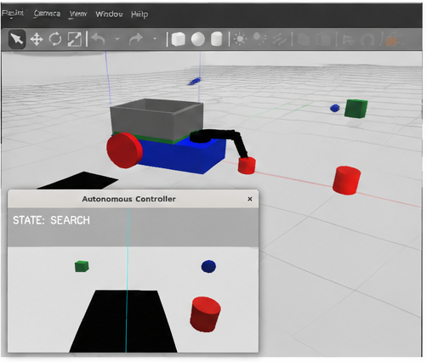
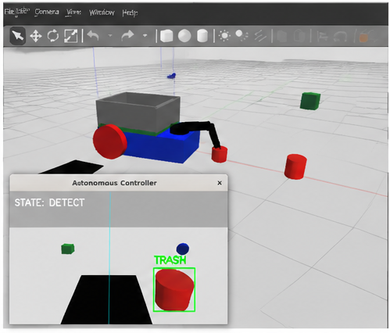
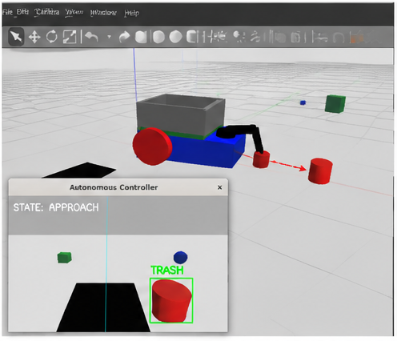
RESULTS AND DISCUSSION
Collection Sequence: Search to Approach
1
Search
2
Detect
3
Approach
The robot scans the environment with its onboard sensors.
A target waste object is identified in the camera view.
Movement commands drive the base toward the detected object.
ROS 2-Based Autonomous Trash Collecting Robot
Notes:
Figure 6 (a)-(c): search, detect, approach. The controller state is shown in the inset window in each panel.

Slide 17
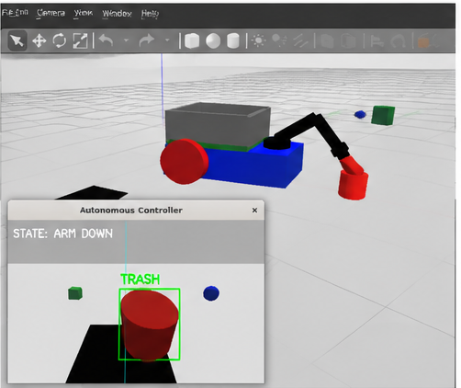
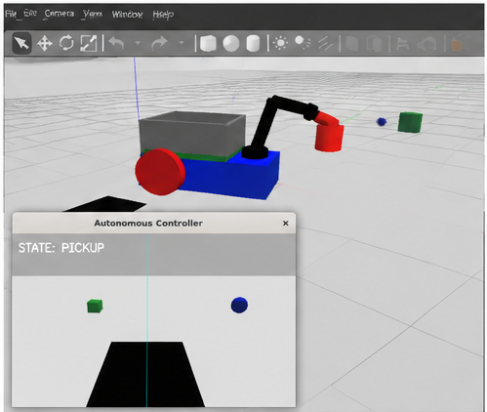
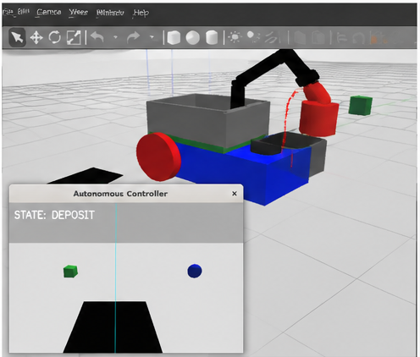
RESULTS AND DISCUSSION
Collection Sequence: Arm Down to Deposit
4
Arm Down
5
Pickup
6
Deposit
At the pickup position the arm lowers toward the object.
The gripper closes and lifts the waste object.
The arm transfers the waste into the onboard container.
ROS 2-Based Autonomous Trash Collecting Robot
Notes:
Figure 6 (d)-(f): arm down, pickup, deposit into the onboard container. Together with the previous slide this is the complete autonomous collection sequence.

Slide 18
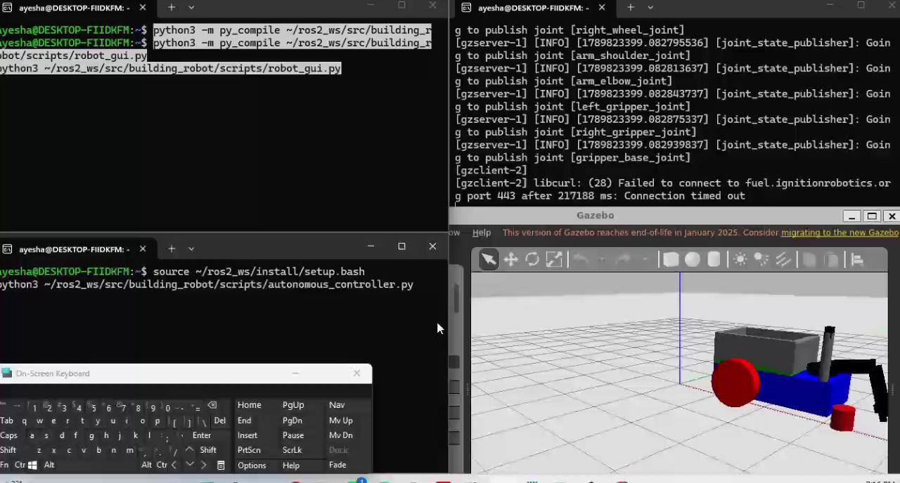
RESULTS AND DISCUSSION
Video Demostration
ROS 2-Based Autonomous Trash Collecting Robot
Notes:
Figure 6 (d)-(f): arm down, pickup, deposit into the onboard container. Together with the previous slide this is the complete autonomous collection sequence.

Slide 19

RESULTS AND DISCUSSION
Functional Evaluation
Trash Detection
Target waste objects identified from camera input
Discussion
Navigation
Robot approached detected waste location
Perception, navigation and manipulation work together to complete the full collection workflow.
Performance depends on accurate detection, camera positioning and arm trajectory control.
Simulation gives a controlled setting to validate the architecture before physical implementation.
Sensor Communication
Camera and LiDAR data integrated through ROS 2
Manipulation
Arm trajectory and gripper operation tested
Collection Workflow
Complete detection-to-disposal sequence evaluated
Evaluation is qualitative and simulation-based.
ROS 2-Based Autonomous Trash Collecting Robot
Notes:
Table V. Each module was evaluated by whether it completed its task in simulation. No numeric metrics are reported in the paper; results are qualitative.

Slide 20


LIMITATIONS AND FUTURE WORK
Challenges and Next Steps
Challenges observed
Future improvements
Camera viewpoint affected object visibility
Arm needed accurate trajectory tuning for reliable grasping
Detection may drop under different lighting or complex backgrounds
Navigation and manipulation modules must stay synchronized
Evaluated in simulation only
Deep learning-based object detection to replace color-based detection
SLAM-based navigation
Improved grasp planning
Validation on a physical robot platform
ROS 2-Based Autonomous Trash Collecting Robot
Notes:
Challenges seen during simulation, and the planned improvements: deep-learning detection, SLAM, better grasp planning, and physical robot validation.

Slide 21


Conclusion
Integrated end-to-end workflow
Detection, approach, grasping and disposal demonstrated in Gazebo Classic with ROS 2.
Modular ROS 2 architecture
Perception, navigation and manipulation communicate through dedicated nodes and topics.
Foundation for real deployment
Simulation today, physical robot next.
Improving perception accuracy and actuator coordination is the path to hardware.
Future work: deep learning detection · SLAM · grasp planning · hardware validation
Notes:
Wrap up: an integrated ROS 2 robot that detects, approaches, grasps and disposes of waste in simulation, and a clear roadmap to hardware.

Slide 22
REFERENCES
Key References
[1] M. M. Islam et al., “Smart waste management robot: Integrating IoT, AI, SLAM, and CNN-based advanced image processing for real-time trash collection and categorization,” Proc. ICCIT, Cox’s Bazar, 2024.
[2] M. S. Hossen et al., “WasteSortBot: An innovative solution for multi-categorical waste separator bin using vision-based control with ROS and cloud computing,” IEEE Access, vol. 13, pp. 183056–183074, 2025.
[3] A. Zaman et al., “SHIFT-T: A low-cost autonomous mobile robot for trash collection and sorting for effective waste management,” Proc. IEEE PEEIACON, 2024.
[4] W. Ma et al., “DSYOLO-trash: An attention mechanism-integrated and object tracking algorithm for solid waste detection,” Waste Management, vol. 178, pp. 46–56, 2024.
[5] Y. Ren et al., “An MRS-YOLO model for high-precision waste detection and classification,” Sensors, vol. 24, no. 13, p. 4339, 2024.
[6] G. Sun and F. Zhang, “DRSE-YOLO: Efficient and lightweight architecture for accurate waste detection,” IET Image Processing, vol. 19, e70022, 2025.
[7] N. Khamis et al., “Development and evaluation of a YOLOv8n-based trash detection system for smart waste management,” Proc. IEEE ICSIMA, 2025, pp. 322–327.
[8] A. R. Chaidir et al., “Integrasi robot lengan beroda holonomic dan pengindraan visual menggunakan YOLOv5 untuk pemilah sampah,” IJEIS, vol. 15, no. 1, pp. 13–24, 2025.
[9] S. S. Dube et al., “Autonomous litter collecting robot with integrated detection and sorting capabilities,” IJLTEMAS, vol. 14, no. 8, pp. 79–85, 2025.
[10] H. Zhou et al., “HGCS-Det: A deep learning-based solution for localizing and recognizing household garbage in complex scenarios,” Sensors, vol. 25, no. 12, p. 3726, 2025.
[11] F. Hu et al., “Scene-guided YOLO framework with contextual feature fusion for solid waste detection in diverse real-world environments,” Discover Artificial Intelligence, vol. 6, p. 1123, 2026.
[12] K. Subhashini et al., “Autonomous floating debris collection system for water surface cleaning,” Proc. IC3IoT, 2024.
[13] A. H. Rad et al., “Design of a container mechanism for trash collection on quadruped robots,” Proc. IEEE/ASME MESA, Genoa, 2024.
[14] S. Maruoka et al., “Study of remote system for autonomous mobile garbage collection robot: remote door operation by robotic arm,” Robotics and Mechatronics Conf., 2025.
[15] Y. Xia et al., “Design and implementation of an intelligent mobile waste classification and collection robot system,” SAE Int., Tech. Rep. 2026-99-0702, 2026.
ROS 2-Based Autonomous Trash Collecting Robot
Notes:
Reference numbers match the citations used throughout the paper.

Slide 23
Thank You!!
Questions and discussion
Notes:
Close and open for questions.

